Slide 1

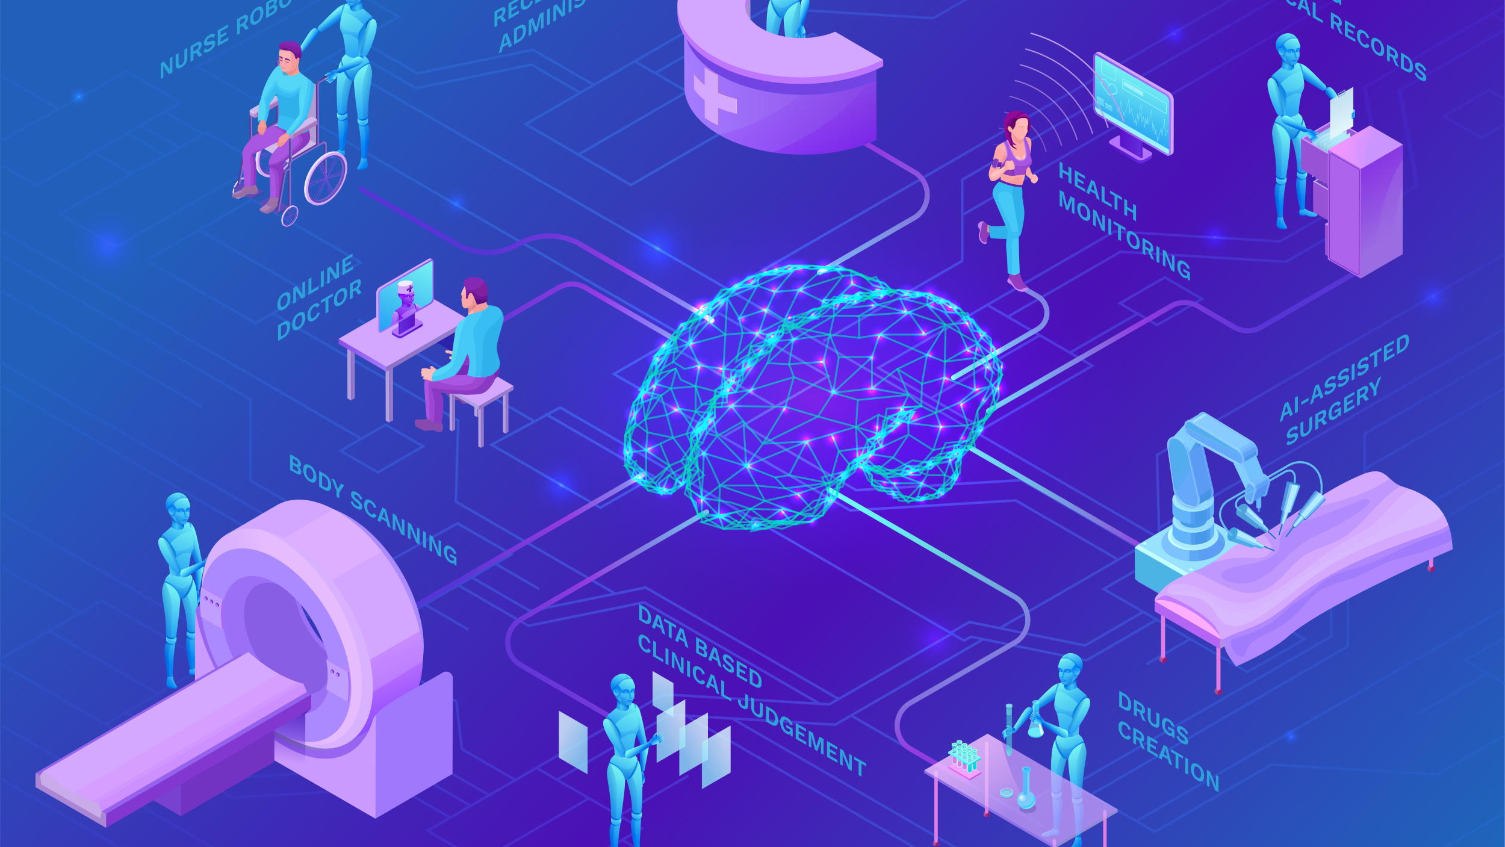
From Pixels to Diagnosis: AI in Pneumonia detection
A Project by
Jani Shariff Shaik

Slide 2



THE NEED FOR INNOVATION IN DIAGNOSIS
Problem Statement: Pneumonia is a severe respiratory infection that poses a global health challenge, particularly in under-resourced regions where timely and accurate diagnosis is difficult. Traditional methods, like manual interpretation of chest X-rays, are often slow, prone to error, and inaccessible in remote areas.
This project develops a deep learning-based neural network using CNNs to automate pneumonia diagnosis from chest X-ray images. The model aims to classify images into pneumonia-positive or normal categories with high accuracy, supporting healthcare professionals in improving diagnostic speed and precision, especially in underserved regions.

Slide 3

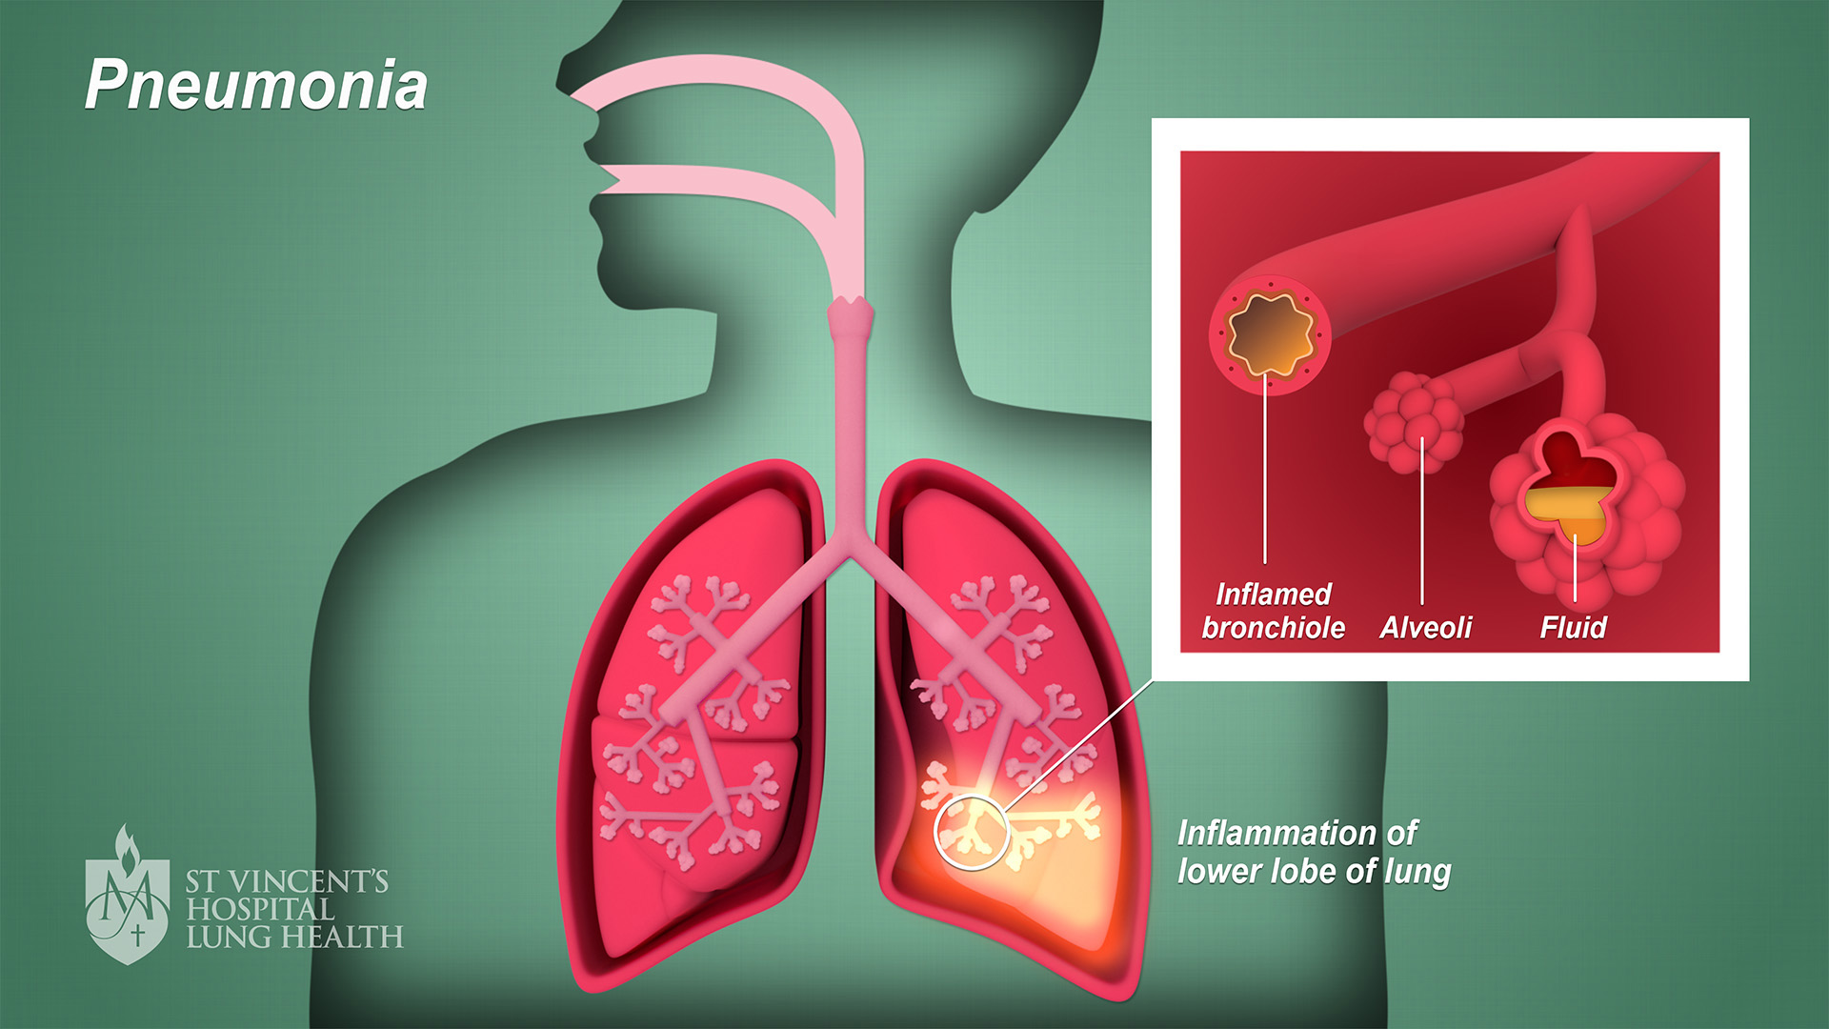
WHAT IS PNEUMONIA?
Definition: Pneumonia is a lung infection that inflames the air sacs, which may fill with fluid or pus.
Symptoms:
Chest pain during breathing or coughing.
Fatigue, fever, or chills.
Shortness of breath.
Importance of Early Detection: Timely and accurate diagnosis can reduce mortality rates significantly.

Slide 4

THE NEED FOR INNOVATION IN DIAGNOSIS
Title: Problem Statement
Content:
Pneumonia is a major global health concern, causing over 2.5 million deaths annually.
Diagnosis traditionally relies on manual interpretation of chest X-rays, which is:
Time-consuming.
Prone to human error.
Limited in under-resourced areas.
Goal: Build a neural network to classify chest X-ray images into pneumonia-positive or normal categories.
Impact:
Accelerate diagnostic processes.
Enhance accuracy and reliability.
Improve access to quality care in remote regions.

Slide 5

HOW A DEEP LEARNING MODEL DETECTS PNEUMONIA
Key Idea: Deep learning uses convolutional neural networks (CNNs) to extract features from chest X-ray images and classify them.
Workflow:
Input: Chest X-ray image.
Feature Extraction: Pre-trained EfficientNetB3 identifies patterns.
Classification: The model predicts if the patient has pneumonia or not.

Slide 6
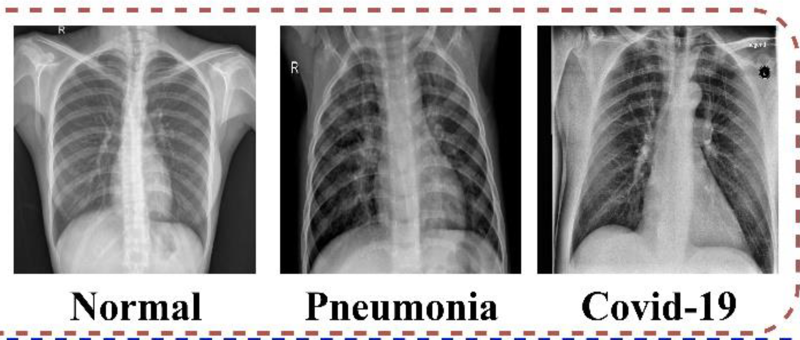
INSPECTION AT X-RAY

Slide 7

DATASET OVERVIEW
Dataset: Chest X-Ray Images (Pneumonia) from Kaggle
Total Images: ~5,800
Categories: Normal, Pneumonia
Dataset Split: Training (5216 images), Validation (16 Images ), Testing (624 Images)

Slide 8
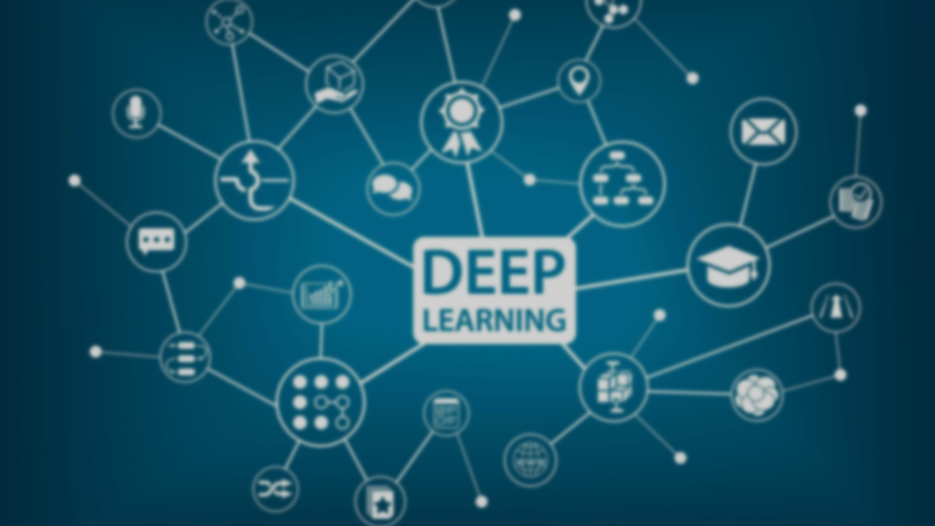
MODEL ARCHITECTURE
Model Used: EfficientNetB3 (pre-trained on ImageNet).
Details:
Layers: Feature extraction, global average pooling, dropout, dense.
Regularization: Dropout and L2 Regularization.
Parameters:
Total: 10,785,072
Trainable: 10,697,769
Non-trainable: 87,303
Include Visual: Add the EfficientNetB3 architecture summary image.

Slide 9
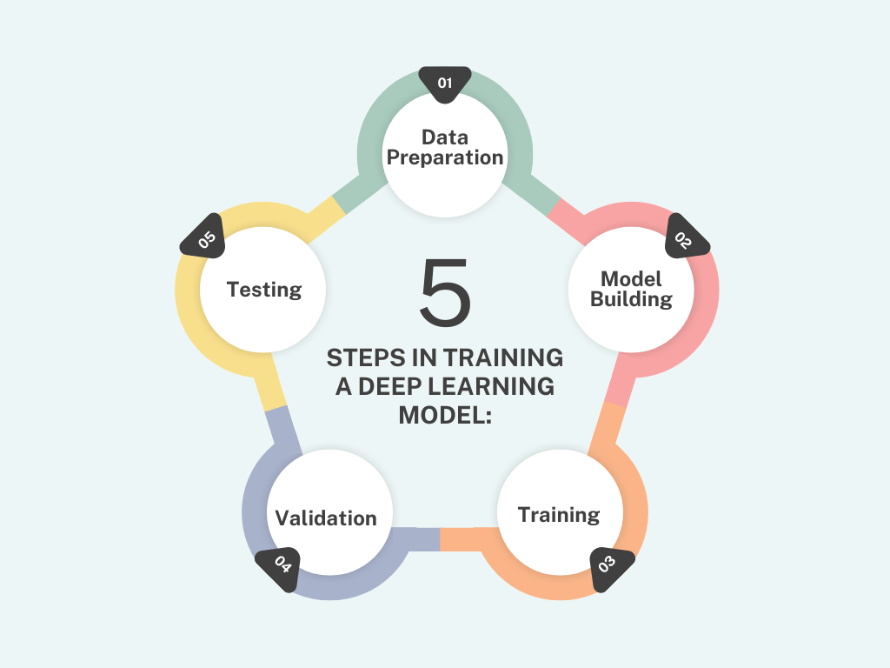
HYPERPARAMETER TUNING
Objective: Optimize model performance by systematically tuning key parameters.
Tuned Hyperparameters:
Learning Rate: [0.001, 0.0005, 0.0001].
Dropout Rate: [0.2, 0.3, 0.4, 0.5].
L2 Regularization: [0.001 to 0.01].
Tool Used: Keras Tuner with Random Search.
Trials and Epochs:
Reduced trials and epochs for efficiency during tuning.
Visual: Add metrics plots for precision, recall, accuracy, and loss over epochs

Slide 10

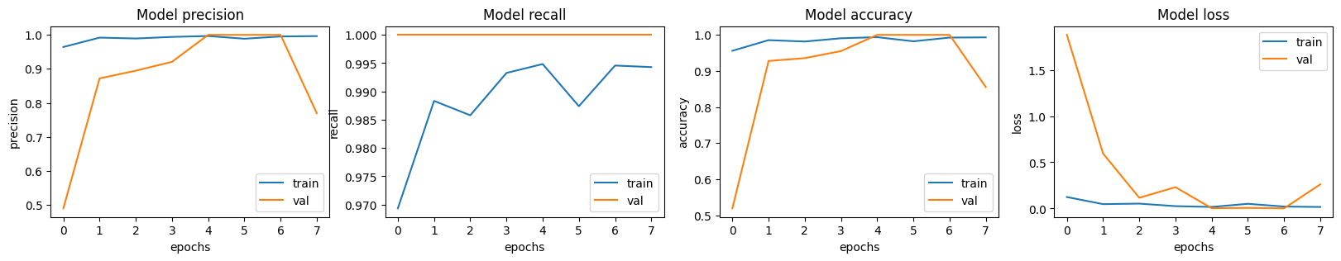
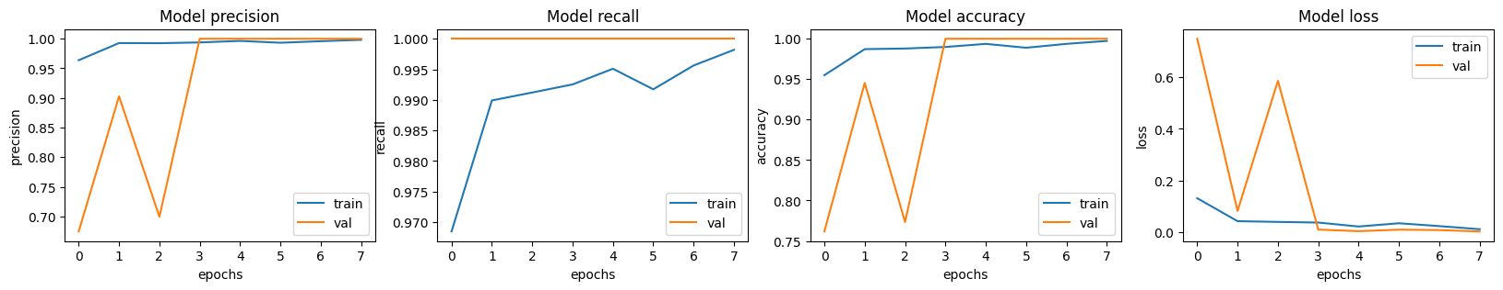
HYPERPARAMETER TUNING

Slide 11

OPTIMIZATION STRATEGIES
Learning Rate Schedule: Dynamically reduced learning rate using Exponential Decay for better convergence.
Regularization:
Dropout: Prevented overfitting by randomly disabling neurons during training.
L2 Regularization: Penalized large weights to simplify the model.
Early Stopping: Stopped training when validation loss showed no improvement for 4 epochs.
Checkpointing: Saved the best model weights for optimal performance.

Slide 12

MODEL EVALUATION
Accuracy: 83.33%.
Precision: 79.4%.
Recall: 99%.
Interpretation:
High recall ensures that the model captures nearly all pneumonia cases.
Precision is slightly lower due to some false positives, but this is tolerable in medical diagnostics as it errs on the side of caution.
The balance between precision and recall makes the model useful for assisting radiologists in identifying pneumonia cases.

Slide 13
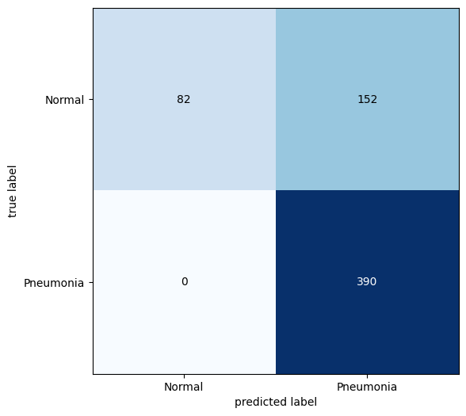
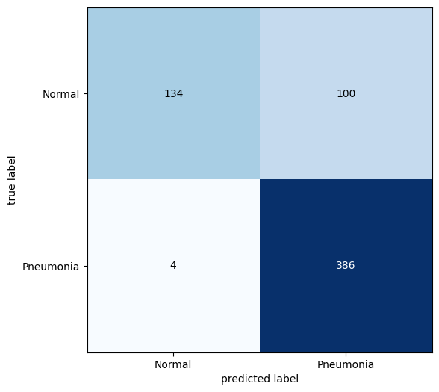
CONFUSION MATRIX

Slide 14

FUTURE WORK
Dataset Expansion: Include diverse X-ray datasets.
Model Optimization: Explore lightweight architectures for faster inference.
Deployment: Build a web application for real-time X-ray diagnosis.

Slide 15

CONCLUSION
Automated pneumonia detection can significantly impact healthcare accessibility.
The project demonstrated the potential of deep learning in medical diagnostics.

Slide 16


Slide 17


